Slide 1
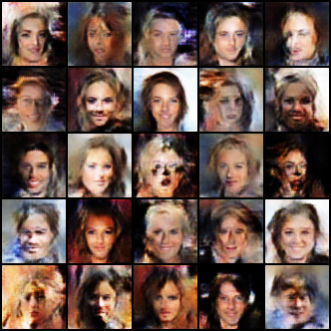
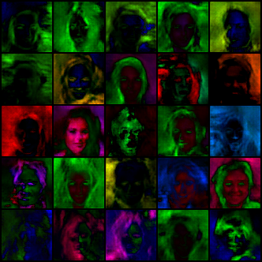
celeba
6000 Iterations
Configs
{
"batch_size": 64,
"epochs": 2,
"interval": 1000,
"n_latent": 64,
"lr": 0.0001,
"channel_sizes_G": [
512,
256,
128,
64
],
"channel_sizes_D": [
64,
128,
256,
512
],
"weight_init": true,
"datatype": "celeba",
"time": 2901.5728046894073
}
Generated images
Grad Cam from output layer

Slide 2
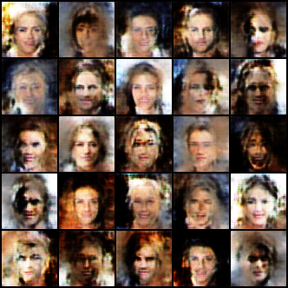
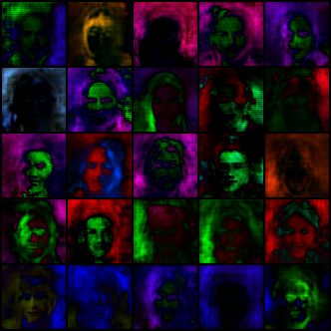
celeba
4000 Iterations
Configs
{
"batch_size": 64,
"epochs": 2,
"interval": 1000,
"n_latent": 64,
"lr": 0.0001,
"channel_sizes_G": [
512,
256,
128,
64
],
"channel_sizes_D": [
64,
128,
256,
512
],
"weight_init": true,
"datatype": "celeba",
"time": 2901.5728046894073
}
Generated images
Grad Cam from output layer

Slide 3
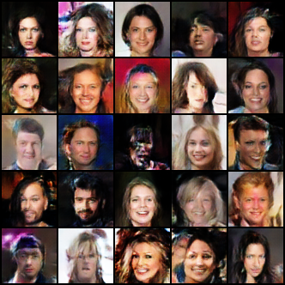
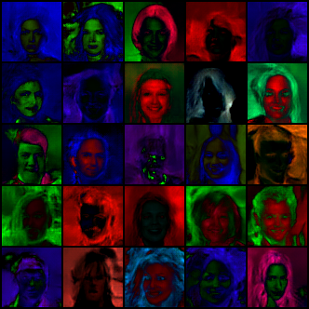
celeba
15500 Iterations
Configs
{
"batch_size": 64,
"epochs": 2,
"interval": 1000,
"n_latent": 64,
"lr": 0.0001,
"channel_sizes_G": [
512,
256,
128,
64
],
"channel_sizes_D": [
64,
128,
256,
512
],
"weight_init": true,
"datatype": "celeba",
"time": 2901.5728046894073
}
Generated images
Grad Cam from output layer

Slide 4
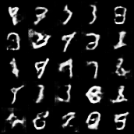
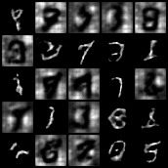
mnist
3000 Iterations
{
"batch_size": 64,
"epochs": 4,
"interval": 1000,
"n_latent": 64,
"lr": 0.0001,
"channel_sizes_G": [
512,
256,
128
],
"channel_sizes_D": [
128,
256,
512
],
"weight_init": true,
"datatype": "mnist",
"time": 379.1541585922241
}
Generated images
Grad Cam from output layer

Slide 5
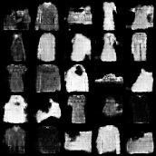
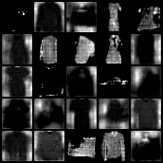
fashionmnist
3000 Iterations
Generated images
Grad Cam from output layer

Slide 6
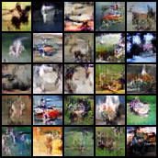
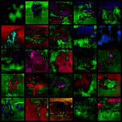
cifar10
9000 Iterations
Generated images
Grad Cam from output layer

Slide 7
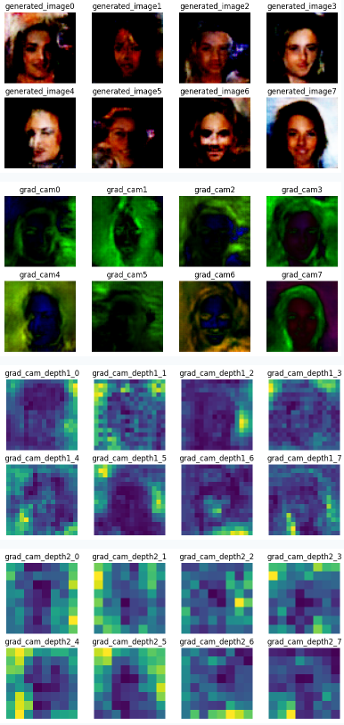

Slide 8

Face
Arm
Letter

Slide 9
